Slide 1
Rapid mix and Flocculation (Coagulation?)
What is the point of Rapid Mix?
Flocculation myths
Ideal flocculators
Sed tank and flocculator designs are connected

Slide 2
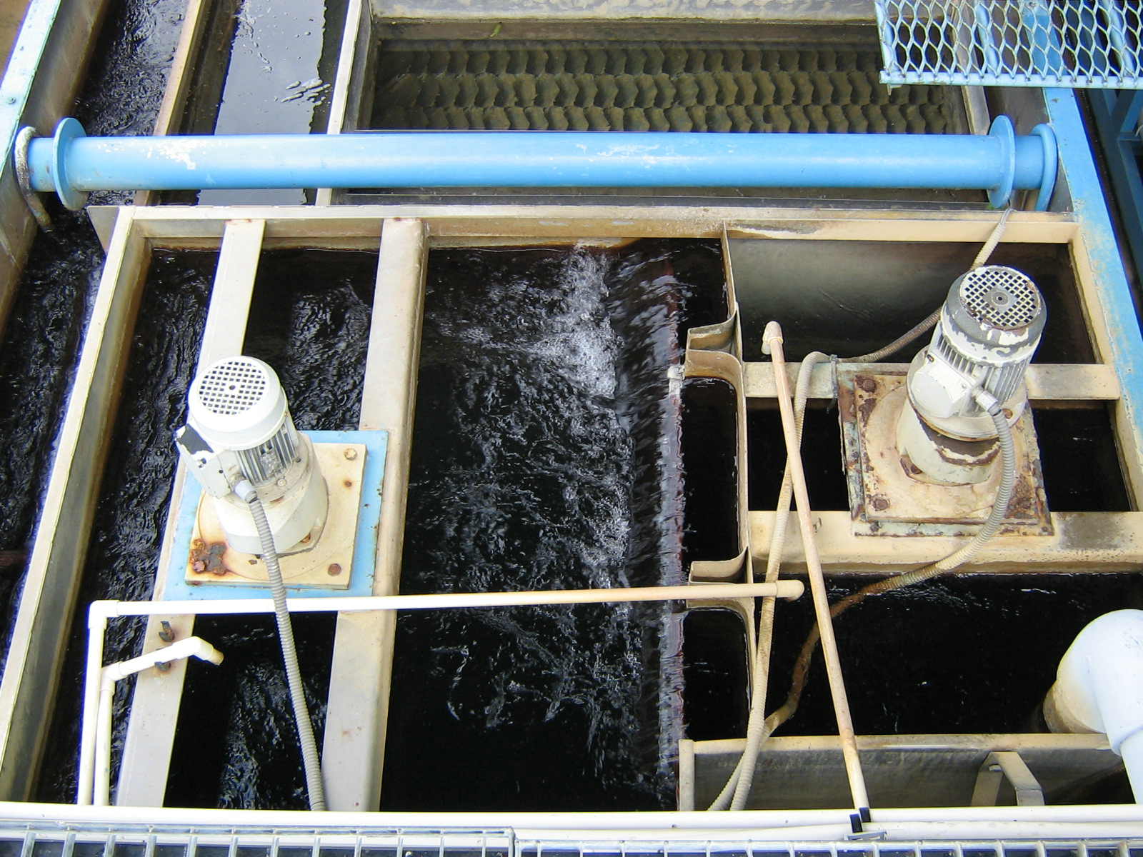

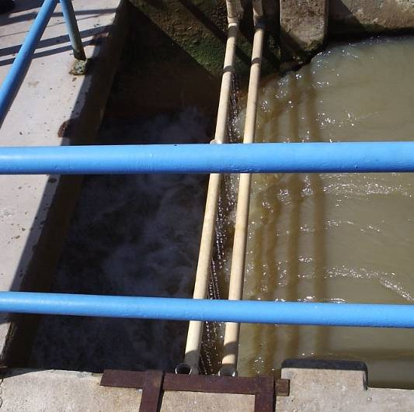

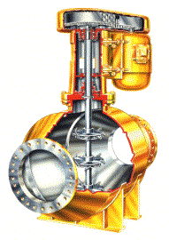
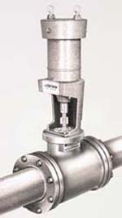
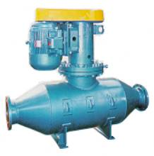
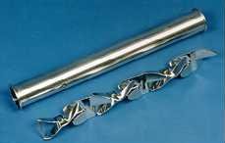
Traditional rapid mix units
Backmix mechanical reactors
In-line blenders
Hydraulic Jump
In-line static mixers

Slide 3
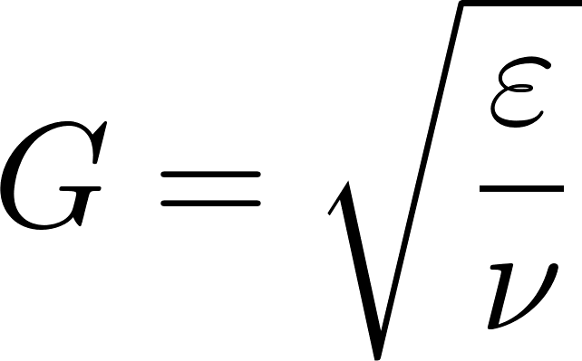
Traditional Design
Conventional design is based on the use of G (velocity gradient) as a design parameter.
We don’t know what the design objective is for rapid mix and thus it isn’t clear what parameter matters
“…a high degree of turbulence leads to more efficient chemical use for destabilization by adsorption and charge neutralization, whereas destabilization by precipitation is less sensitive to the mixing conditions.” (Water Quality Engineering – Benjamin and Lawler, 2013)
In drinking water treatment the coagulant dosages are almost always higher than the solubility limit; Thus it is very likely that rapid mix isn’t important!
Energy dissipation rate
Kinematic viscosity

Slide 4
Rapid mix is the most energy intensive operation in conventional water treatment
And we don’t know why we are using all of this energy!
Some plants have experimented with turning rapid mix off
Mixing will occur in the flocculator and will use much less energy
Perhaps the only need for rapid mix is to ensure that coagulant is blended with all of the water before the water is split into parallel flocculation trains

Slide 5
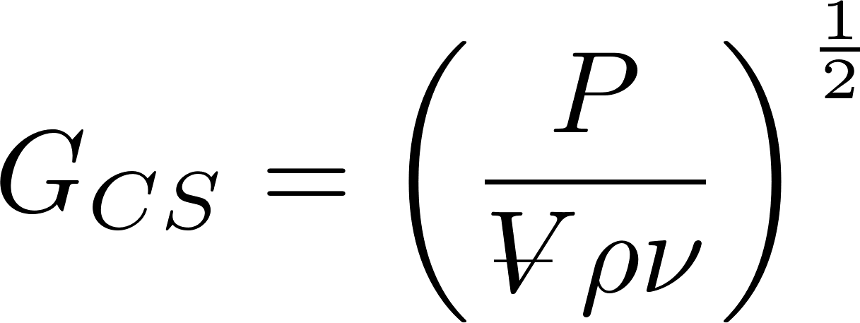
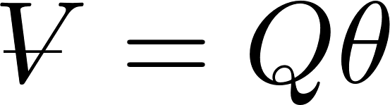
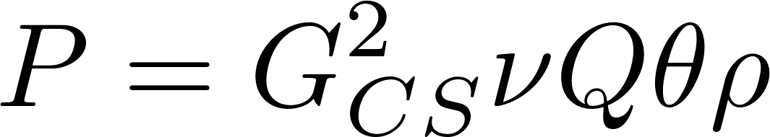
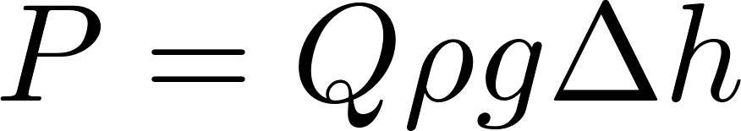
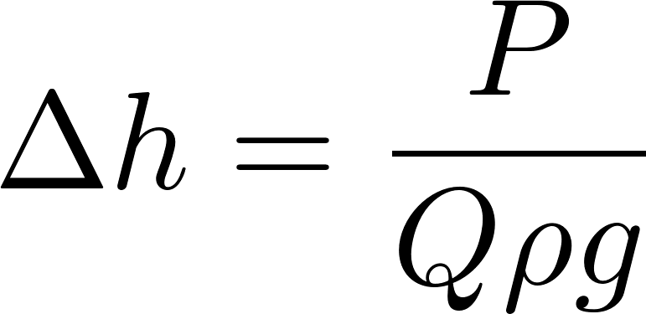
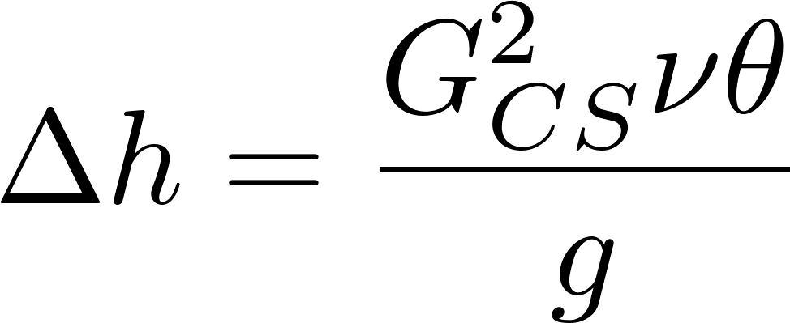
Rapid Mix and Flocculation: Power, Height, and Velocity Gradient
“velocity gradient” caused by mixing
Reactor volume
Power required
Power required to lift water
Equivalent potential energy measured as a height used for mixing
Equivalent potential energy as a function of G
Notes:
from Environmental Engineering: A Design Approach by Sincero and Sincero. 1996. page 267

Slide 6
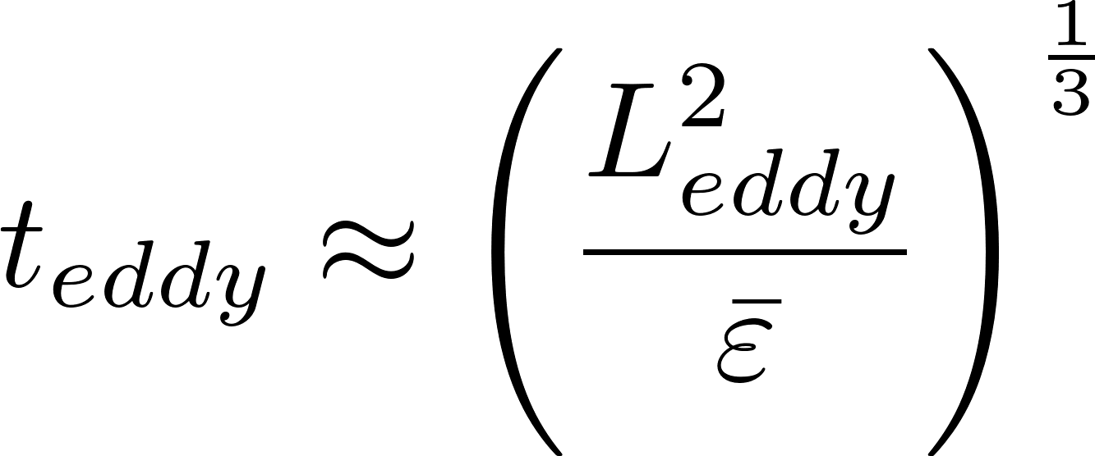
Energy efficient hydraulic rapid mix in an open channel
Calculate the large eddy velocity and hence the distance the water flows during the time required for the large eddies to mix the flow
See AguaClara textbook example (https://aguaclara.github.io/Textbook/Rapid_Mix/RM_Examples.html#example-problem-energy-dissipation-rate-in-a-straight-pipe)
This level of mixing does not require much energy!

Slide 7
How would you design hydraulic mixing in a channel?
How can you make eddies that are the size of the largest dimension of the flow?
How would you change this channel?
Where does the coagulant injection point go?
Notes:
One big flow expansion at the scale of the total flow will be useful to generate big eddies

Slide 8
The Conventional Coagulation Hypothesis* The coagulant neutralizes negative surface charge
“The purpose of addition of coagulant chemicals is to neutralize the negative charges on the colloidal particles to prevent those particles from repelling each other.
Coagulants due to their positive charge attract negatively charged particles in the water.” http://www.thewatertreatments.com/wastewater-sewage-treatment/coagulation-flocculation-process/
* This myth has been the explanation of coagulation for close to 100 years (and there is significant evidence that it does NOT explain drinking water treatment)
Notes:
Notice the focus on eliminating repulsion. We now suspect that the coagulant precipitate is attracted to particle surfaces.

Slide 9
Sweep Floc Myth Coagulant sweeps up particles???????????
It is clear that charge neutralization doesn’t explain flocculation in water treatment plant
Sweep floc was invented as a “mechanism” to explain everything that was unexplainable
“Enmeshment or sweep floc-Entrapment or capture of particles by amorphous precipitates that form when a coagulant is added to water”
Entrapment is not a physical mechanism
No equations describing this mechanism!

Slide 10
Coagulation: The adhesive nanoparticle hypothesis
Aluminum coagulants (alum and polyaluminum chloride) produce adhesive nanoparticles of precipitated aluminum hydroxide that attach to particles including to other nanoparticles
Same mechanisms likely applies to iron based coagulants too
Coagulant nanoparticles are sticky!
Coagulant nanoparticles can also self-aggregate
Predictive performance model for hydraulic flocculator design with polyaluminum chloride and aluminum sulfate coagulants Karen A. Swetland, Monroe L. Weber-Shirk*, Leonard W. Lion

Slide 11
Coagulant precipitate as additional particles to speed up collisions
Adding an excess of coagulant so that it forms additional particles to increase the rate of particle collisions
Maybe this is what previous authors meant when they use the term “sweep” floc

Slide 12
Flocculation primer
Flocculation is creating gentle collisions by deforming the fluid (fluid shear or velocity gradient)
Particles travel with the fluid
Particles collide because they travel at the velocity of streamline that goes through their center and because they have a diameter that extends into fluid that is moving at a different velocity
Particles only collide with similar sized particles in shear flow
Our goal is to transform small particles into bigger flocs

Slide 13
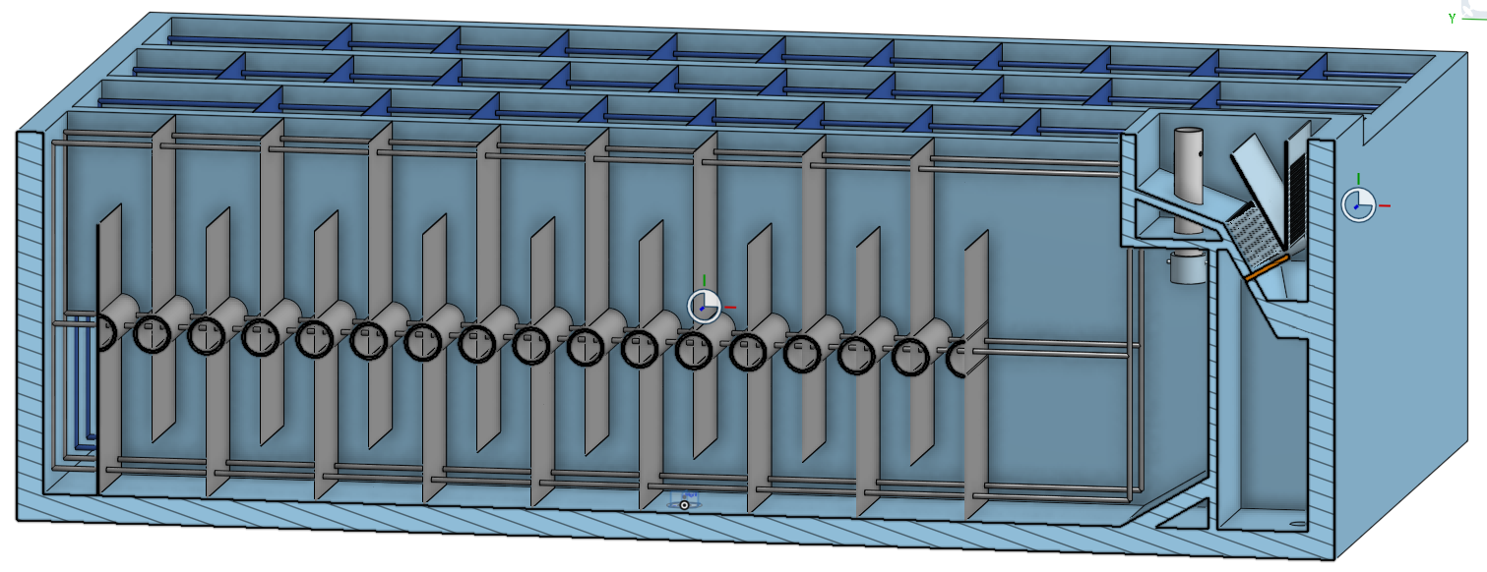
Ideal Flocculator
Plug flow
Serpentine path
CMFR in series
Uniform energy dissipation rate
Produce large scale eddies
Slow moving large paddles
Enough fluid deformation to produce flocs that can be captured by the sed tank

Slide 14
Flocculator design depends on sedimentation tank design
If the sedimentation tank includes a floc blanket, then the flocculator doesn’t have to produce large flocs (lower Gθ is okay)
The floc blanket will increase the size of the flocs
Floc blanket eliminate the need for mechanical sludge removal
Without a floc blanket the capture velocity of the plate settlers must be low enough so that the plates can capture the majority of the flocs produced by the flocculator
We don’t yet have a model for this (We are working on it)

